Slide 1
Demystify Buzzwords
Machine Learning

Slide 2
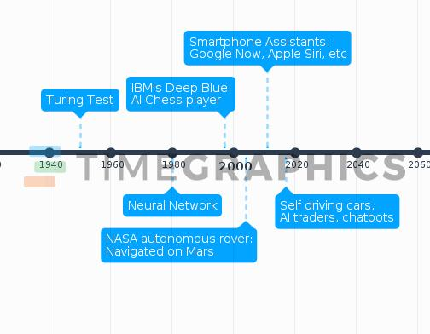
Time travel

Slide 3
Types
Machine Learning
Trainings
Tasks
Trends
Tools

Slide 4
Types
Machine Learning
Supervised
Unsupervised
Clustering
Reinforcement
Mari/o : ai plays mario
Regression
Classification
what is the price of house in a specific city?
this mail is spam or not?
given news articles,cluster into different types of news

Slide 5
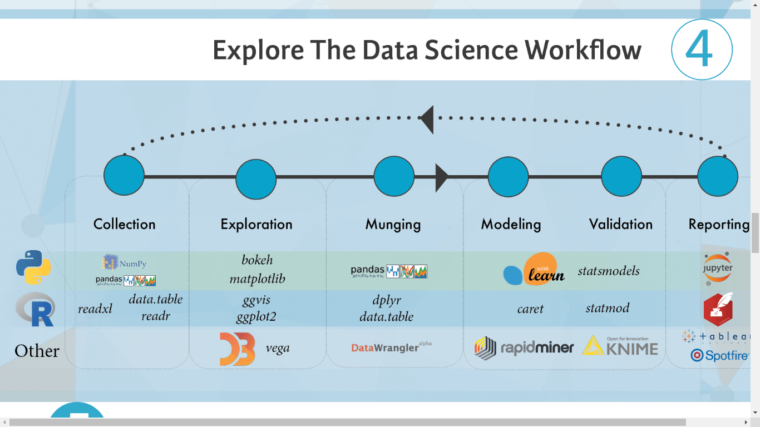
Tasks

Slide 6
Tools

Slide 7
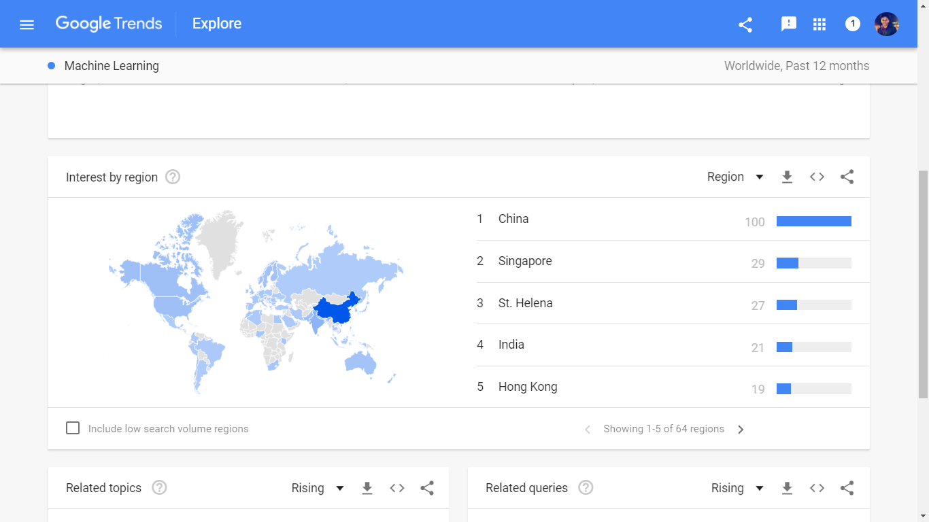
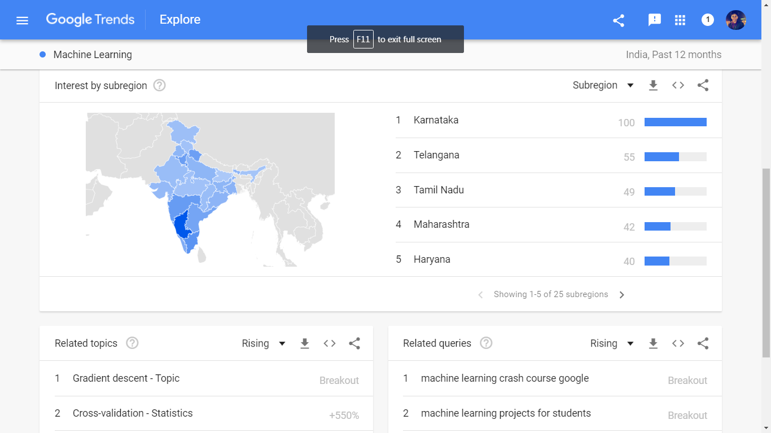
Trends

Slide 8





Trainings

Slide 9
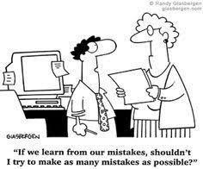
Thank you

